Slide 1
Digging into Data – Labour Markets Dr Ted McDonald, Director DataNB Professor, University of New Brunswick October 28 2025

Slide 2

Definitions
Administrative Data – data collected in the course of government delivering services and administering programs
Secondary data use – using data that was originally collected for other purposes (e.g. research)
FAIR – data should be findable, accessible, interoperable and reusable

Slide 3

Occupation
Skill mismatch is an ongoing issue of concern for policymakers and employers
Current and future expected skill shortages in certain occupations such as nursing have influenced both postsecondary education and immigration policy decisions
Yet data on occupation in Canada is limited

Slide 4
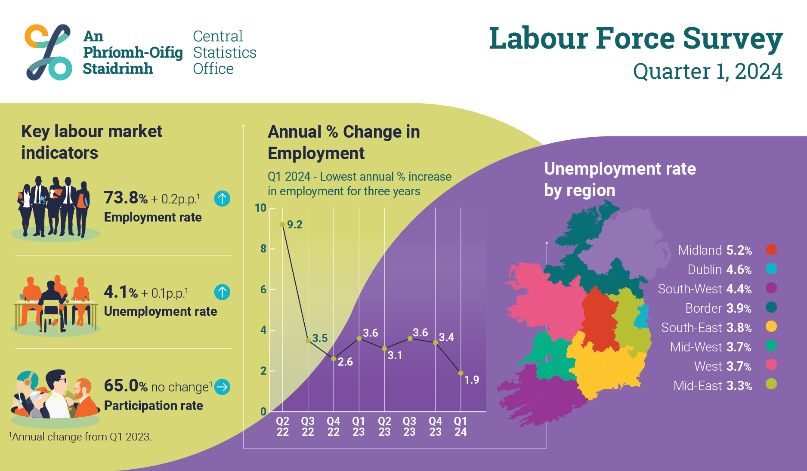
Typical data sources for occupation
Population Census (self reported)
Labour Force Surveys (self reported)
Surveys of Employers (self reported)
Workers’ Compensation Claim data (administrative)

Slide 5
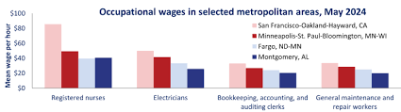
US Bureau of Labor Statistics : Occupational Employment and Wage Statistics
Employment and wage estimates for ~ 830 occupations based on a survey of about 1.1 million non-farm business establishments collected over a 3-year period
Cross-industry occupational employment and wage estimates by region, industry and ownership structure

Slide 6
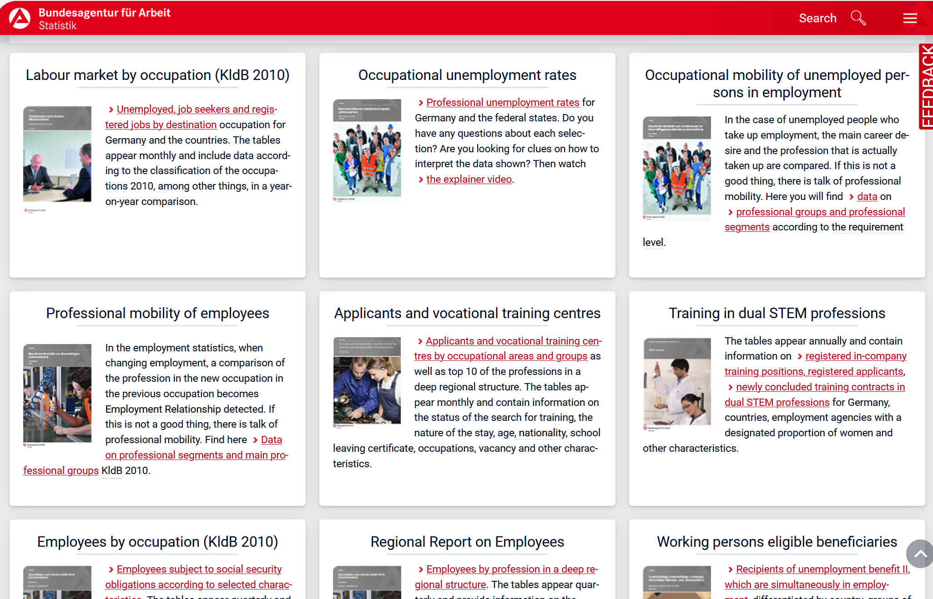
Germany - Federal Employment Agency
Employment agency Business Data
Company reporting to Social Insurance Institutions

Slide 7

What is a regulated occupation?
Professions and skilled trades that are overseen by a provincial regulatory body and require a license, certification, or registration to practice
These regulatory bodies set and enforce standards to protect the public
Establish educational standards
Issue licenses to practice
Ensure competence through continuing education
Investigate complaints or misconduct
Notes:
. The primary goals of these regulators are to ensure public safety, quality of services, and fairness within an industry.

Slide 8

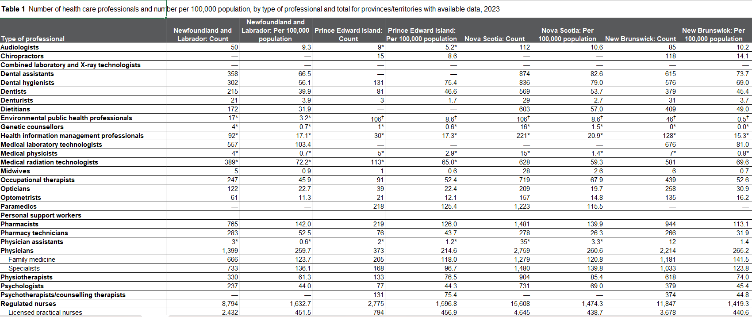
Aggregate Statistics
https://healthworkforce.ca/dashboards/workforce-in-view/recruitment-and-retention/

Slide 9


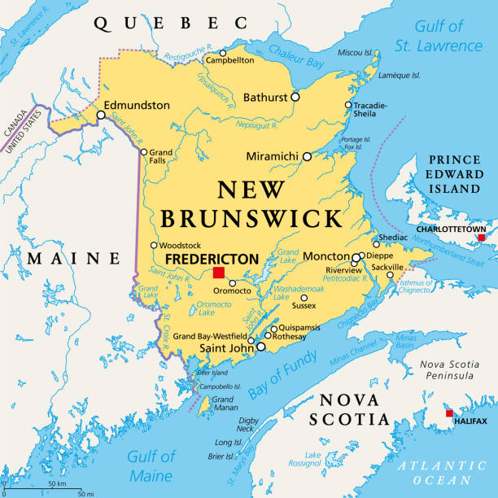

Individual linked data: DataNB
NB Graduation Data
Regulatory Data
Payroll Data
Demographics
Institution | Years available
Universities | 2004-2023
Community colleges | 2014-2023
Institution | Years available
Regist. Nurses | 2004-2023
Paramedics | 1980-2024
Social Workers | 2008-2024
Data type | Years available
RN & LPN public sector | 2016-2024
Data type | Years available
Place of residence | 2000-2024
Linkage using name and birthdate (address when available)

Slide 10
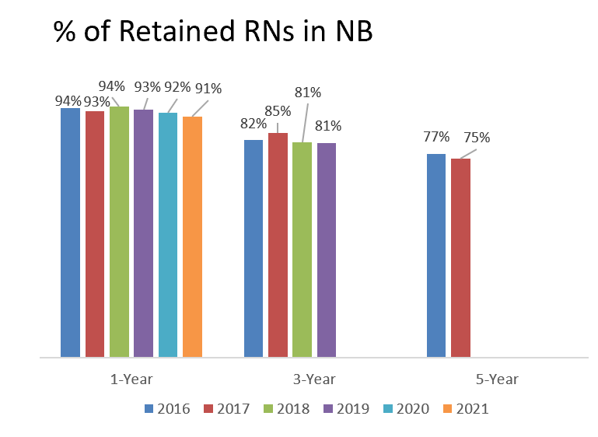
Key policy questions for health human resource planning
Among HHR graduates from NB institutions, who transitions into employment in NB?
How long do people employed as HHR remain working and why do they leave?
Among those that cease work in the occupation, who stays in NB and who leaves?
Notes:
. The primary goals of these regulators are to ensure public safety, quality of services, and fairness within an industry.

Slide 11






Future State?

